Slide 1
Air Pollution in India’s Four Cities
Pre / Post COVID-19
Emma Lipari, Brandon Mohammed, Anjelica Ramsey,
Shivani Thakkar, Sanjaye Thomas

Slide 2
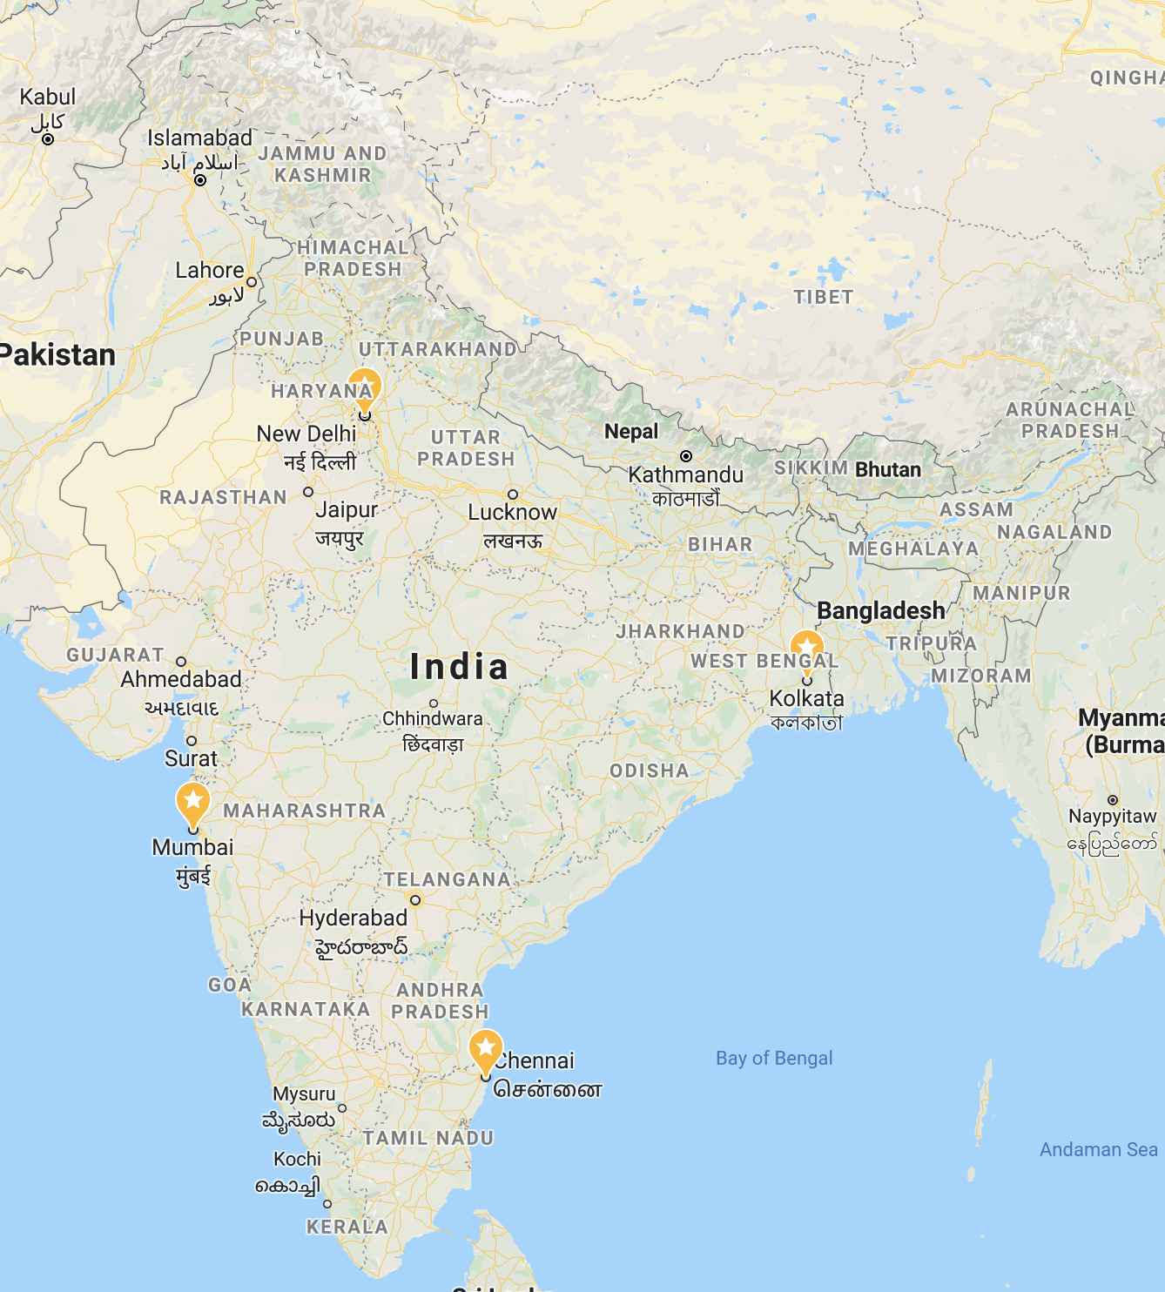
Project Abstract
Each year, India can be found among the countries with the worst levels of air pollution on global indices. The most common such pollutant measured within this metric is CO (carbon monoxide), while high levels of trace pollutants, such as SO2 (sulfur dioxide), O3 (ozone), and NO2 (nitrogen dioxide), serve to further substantiate poor regional air quality.
The production of said pollutants can be derived from the combustion of fossil fuels and alternative energy sources, of which India can be considered a significant global consumer.
Currently, India is undergoing a significant lockdown within major population centers due to COVID. Our data science project seeks to prove a hypothesis that an effective lockdown should lead to a sizable decrease in pollutants within the cities of Mumbai, Delhi, Chennai, and Kolkata.
Notes:
In this project, we will analyze and create visualizations that compare the air pollution in India’s four major cities pre and post COVID-19 times.

Slide 3
City Profiles
Fun fact:
New York City density is 11,000 people per km²
Chennai
Population (2019): 4,328,063
Density: 26,553 km² Growth: 2.54%
Industry: automobile, computer, technology, hardware manufacturing and healthcare sectors.
COVID status: Strict lockdown
Delhi
Population (2019): 10,927,986
Density: 20,412 km² Growth: 3.03%
Industry: formation technology, telecommunications, hotels, banking, media, and tourism
COVID status: Phase I Reopening
Mumbai
Population (2019): 12,691,836
Density: 32,000 km² Growth: 1.12%
Industry: finance, jewellery, leather processing, IT, textiles, and entertainment.
COVID status: Phase I Reopening
Kolkata
Population (2019): 4,631,392
Density: 24,000 km² Growth: 0.59%
Industry: Financial hub, major commercial and military port,
COVID status: Strict lockdown
Notes:
NYC population 8,399,000; decrease of around 0.01% from last year; 11000 people per square km

Slide 4
Summary Table - Carbon Monoxide (CO per µg/m3)
City | Mean | Median | Standard Deviation | Variance | SEM
Chennai | 1007.000000 | 990.0 | 120.398461 | 14495.789474 | 26.921914
Delhi | 664.333333 | 440.0 | 376.047350 | 141411.609195 | 68.656539
Kolkata | 263.636364 | 260.0 | 38.858161 | 1509.956710 | 8.284588
Mumbai | 420.555556 | 420.0 | 87.209836 | 7605.555556 | 20.555556
June 22nd, 2020

Slide 5
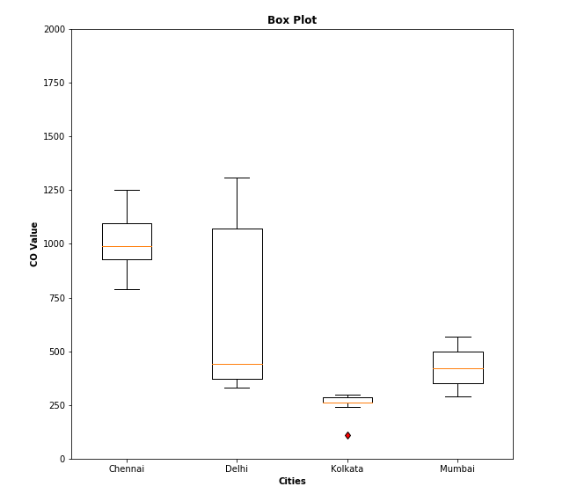
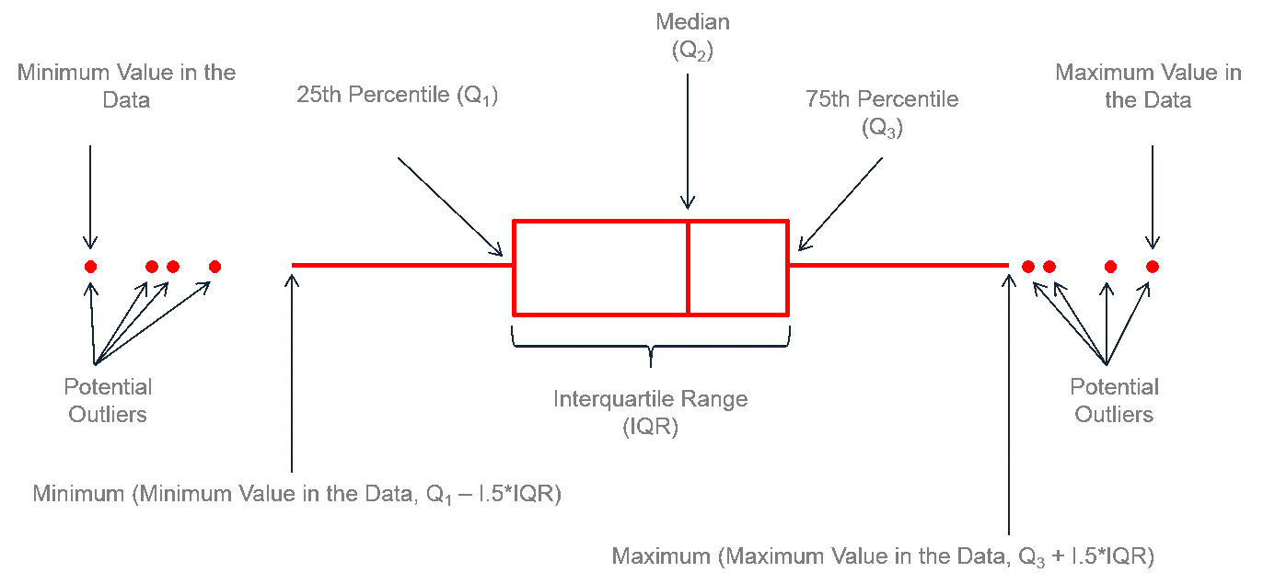
CO Levels throughout the Day (June 22nd, 2020) in Each City
Kolkata had one outlier first interquartile at 218.75 µg/m3
Kolkata has the smallest IQR at 260.0 µg/m3
Kolkata had the smallest standard deviation at 38.8 µg/m3
→ low change throughout day
Delhi had the largest IQR at 700.0 µg/m3
Delhi had the largest standard deviation at 376.1 µg/m3
→ high change throughout day
Limitation in box plot: does not show time

Slide 6
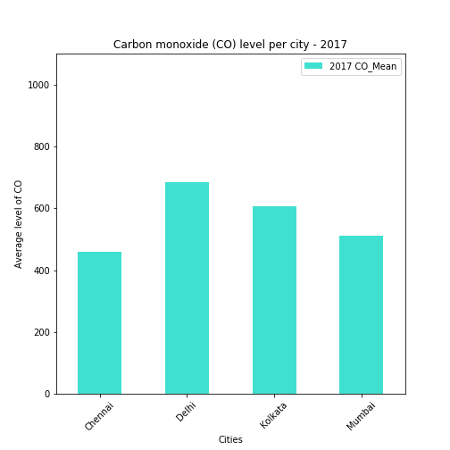
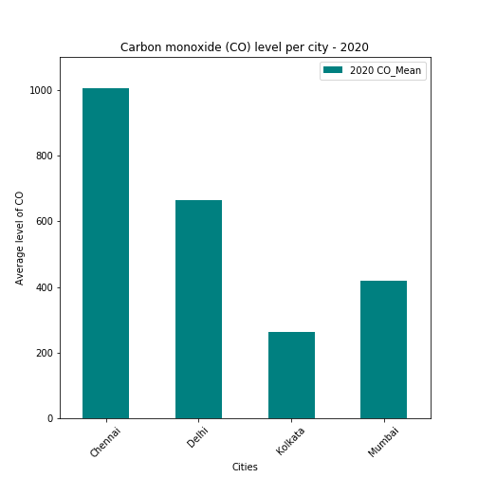
Average Level of CO in Each City -2017/2020
Chennai to grow population 2.5 times by year 2025.
Kolkata had a decrease correlated with strictly following COVID lockdowns
Delhi and Mumbai have little change

Slide 7
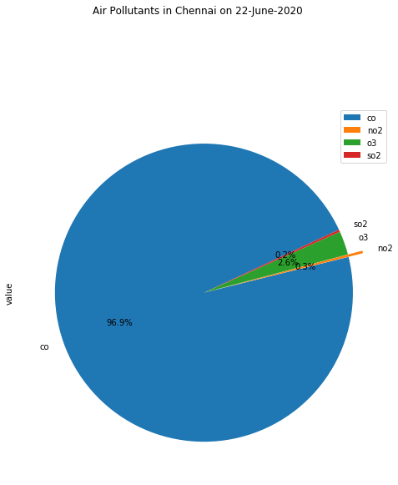
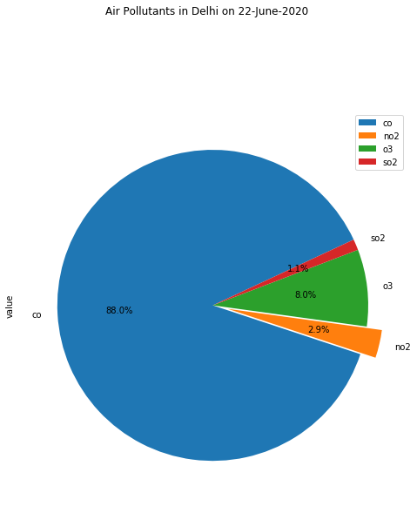
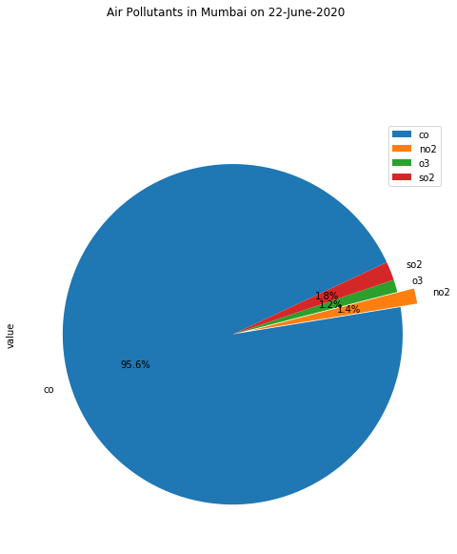
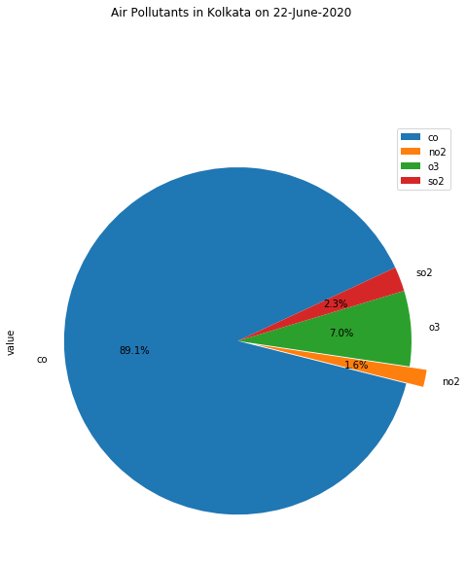
Chennai
New Delhi
Mumbai
Kolkata
Pie Charts of City Pollutants during “COVID” era
June 22nd, 2020
Notes:
Main pollutants. CO has the highest pollutants amongst all four cities. Derived from alternative fuels and production

Slide 8
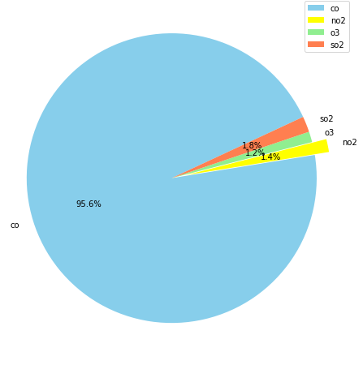
2017
2020
Mean CO levels: 510.8
Mean CO levels: 420.5
Mumbai Pre / Post COVID
Notes:
Mumbai less strict (phase 1 reopening)

Slide 9
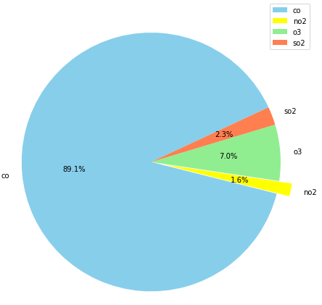
2017
2020
Mean CO levels: 607.1
Mean CO levels: 260.0
Kolkata Pre / Post COVID
Notes:
Kolkata strict lockdown

Slide 10

Analysis
CO remains the main pollutant with a range of 88.0-96.6% in all four cities
The ratios of pollutants remains nearly unchanged pre/post COVID.
Chennai has the highest CO pollution at 1007.00 µg/m3, whereas Kolkata had 263.63 µg/m3.
The large Stdev of CO values in Mumbai supports the existence of high levels of industry in the city within the COVID period.
There is no major redistribution of carbon monoxide (CO) to trace pollutants in the air for our four regional cities, between the COVID period and a historical time period 3 years earlier.

Slide 11

Hurdles
Narrowing down the scope
Where and when
Finding an API with historical data
Cleaning the data
Leverage Python for historical data
Historical inconsistencies
Framing visualizations
Cohesive analysis
Creating a comprehensive project within a limited timeframe
Notes:
- China was an option but there was not enough info so we had to pivot and landed on India
Even for India, we realize fast that we could not pull the historical data using an API to call
So we had to leverage the historical CSV and use python to clean the data
We were very thoughtful of the visuals to show because that was important to illustrate our findings
Working within the time constraints was a challenge, but given more time we could have perhaps done a scatter plot with a regression analysis

Slide 12
Final Thoughts
Expected a more consistent drop between all four cities between pre/post COVID.
Chennai INCREASED in its CO levels
COVID has a silver lining with its positive environmental changes.
Air Quality Data & Analysis can be used as a determinant of community health.
Notes:
An article we read suggests that it may be due to high humidity, but do to time constraints we did not analyze further

Slide 13
Resources
The Natural Resources Defense Council
India’s consumption
API: OpenAQ, Archived CSV files
Longitudinal and Cross Sectional Studies
https://www.worldometers.info/demographics/india-demographics/
https://worldpopulationreview.com/world-cities/kolkata-population/

